Slide 1
RMI
RemoteObject
RMI Architecture
Developing Applications with RMI
Designed by Trendz R&D Team

Slide 2
What is RMI?
RMI stands for Remote Method Invocation.
It is the new way of communication between two JVMs.
RMI allows developer to invoke the methods of an object existing on a different computer (or JVM), in the same manner as invoking local methods.
Designed by Trendz R&D Team

Slide 3
What Is RMI?
Access to Remote Objects
Java-to-Java only
Client-Server Protocol
High-level API
Transparent
Lightweight
Designed by Trendz R&D Team

Slide 4
Features of RMI
RMI is similar to Remote Procedure Call (RPC) mechanism in other languages.
RMI is useful for developing distributed applications.
In other words, RMI is very useful for developing Client/Server applications.
Designed by Trendz R&D Team

Slide 5
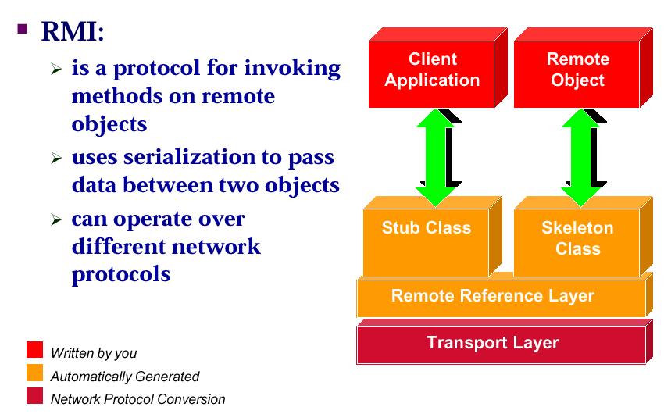
Remote Objects
Designed by Trendz R&D Team

Slide 6
Remote Objects
Remote Objects
  Live on server
  Accessed as if they were local
Designed by Trendz R&D Team

Slide 7
Remote Interface
Objects that want their methods to be called remotely must use one or more remote interface.
Remote methods are defined by remote interfaces.
Designed by Trendz R&D Team

Slide 8
RMI Server & Client
The object that implements or uses the remote interface is called Server.
The object that invokes the remote methods is called the Client.
An object can be both a client and a server.
Designed by Trendz R&D Team

Slide 9
Layers in RMI
A RMI application is made up of the following layers:
Application Layer
Stub and Skeleton Layer
Remote Reference Layer
Transport Layer
Designed by Trendz R&D Team

Slide 10
Stubs and Skeletons
Stub
  lives on client
  pretends to be remote object
Skeleton
  lives on server
  receives requests from stub
  talks to true remote object
  delivers response to stub
Designed by Trendz R&D Team

Slide 11
Application Layer
An application that wants to make its methods available to remote clients must declare the methods in an interface that extends java.rmi.Remote.
In the remote interface, an exception called RemoteException is thrown which has to be handled.
Designed by Trendz R&D Team

Slide 12
Application Layer
Once the methods declared in the remote interface have been implemented, the object must be exported.
This can be done implicitly if the object extends the UniCastRemoteObject class of java.rmi.server package.
It can be done explicitly with a call to the exportObject() method of the same package.
Designed by Trendz R&D Team

Slide 13
Remote Reference Layer
Local pointer’s not good enough
Figures out which remote object is being referenced
Could span multiple virtual machines
Communicates via TCP/IP
Designed by Trendz R&D Team

Slide 14
Transport Layer
Deals with communications
Connection management
Dispatching messages between stub and skeleton
Distributed Garbage Collection
Sits on top of java.net
Designed by Trendz R&D Team

Slide 15
Registries
Name and look up remote objects
Servers can register their objects
Clients can find server objects and obtain a remote reference
A registry is a running process on a host machine
Designed by Trendz R&D Team

Slide 16
RMI System Architecture
Client Virtual Machine
Server Virtual Machine
Client
Remote Object
Skeleton
Server
Stub
Designed by Trendz R&D Team
Registry Virtual Machine
“Fred”

Slide 17
RMI Flow
1. Server Creates Remote Object
2. Server Registers Remote Object
Client Virtual Machine
Server Virtual Machine
Client
Remote Object
1
Skeleton
Stub
Server
Designed by Trendz R&D Team
2
“Fred”
Registry Virtual Machine

Slide 18
RMI Flow
Client Virtual Machine
Server Virtual Machine
Client
Remote Object
3. Client requests object from Registry
4. Registry returns remote reference
(and stub gets created)
Skeleton
Stub
Server
Designed by Trendz R&D Team
3
4
“Reg.Name”
Registry Virtual Machine

Slide 19
RMI Application Steps
In RMI Application we have to implement
The following Programs.
Remote Interface XxxxRemote.java
Class XxxImpl.java
Server XxxxServer.java
Client XxxxClient.java
Designed by Trendz R&D Team

Slide 20
RMI Application Steps
Remote Interface
1)Remote Interface should extends java.rmi.Remote
2)In Remote Interface we have to declare
  All business methods that can be accessed by client
3)All methods in Remote Interface should throw
Java.rmi.Remote Exception
Designed by Trendz R&D Team

Slide 21
RMI Application Steps
Impl Class
  1)This class should implements java.rmi.UnicastRemoteObject,Remote Interface
  2)This class should implements all business methods that are declared as part of RemoteInterface.
Designed by Trendz R&D Team

Slide 22
RMI Application Steps
RMI Server
  In Server Program we have to create an object of XxxImpl class
  Then we have to register that object on RMI Registry using rebind method in java.rmi.Naming class with user friendly names.
  So that a RMI Client can lookup for this object from RemoteM/C.
Designed by Trendz R&D Team

Slide 23
Compiling Remote Classes (Diagram)
Adder.java
(interface)
javac
Adder.class
(interface classfile)
AdderImpl_Skel.class
(skeleton classfile)
Designed by Trendz R&D Team
AdderImpl.java
(remote class)
javac
AdderImpl.class
(classfile)
rmic
AdderImpl_Stub.class
(stub classfile)

Slide 24
RMI Application Steps
RMI Client
  In RMI Client Program we have to lookup for object on RMI registry
  Using lookup method in java.rmi.Naming class
  So that Client get the reference of Remote Object
  Then Client can invoke all business methods
Designed by Trendz R&D Team

